Slide 1
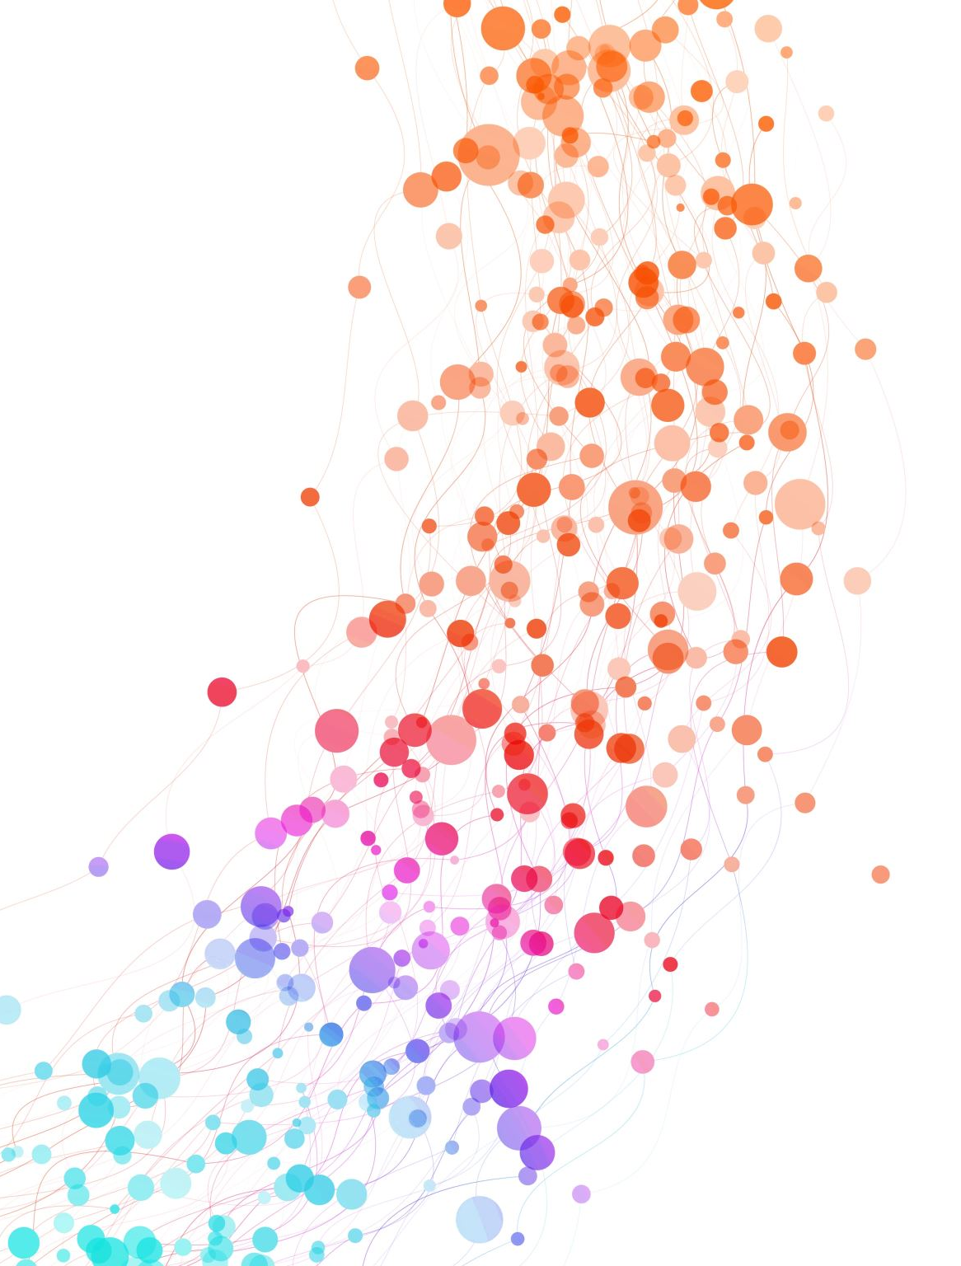
Inductive t-SNE via deep learning to visualize multi-label images (2019)
Instituto Tecnológico Autónomo de México (ITAM), Mexico City, Mexico
CVM Lab - University of Geneva, Geneva, Switzerland

Slide 2
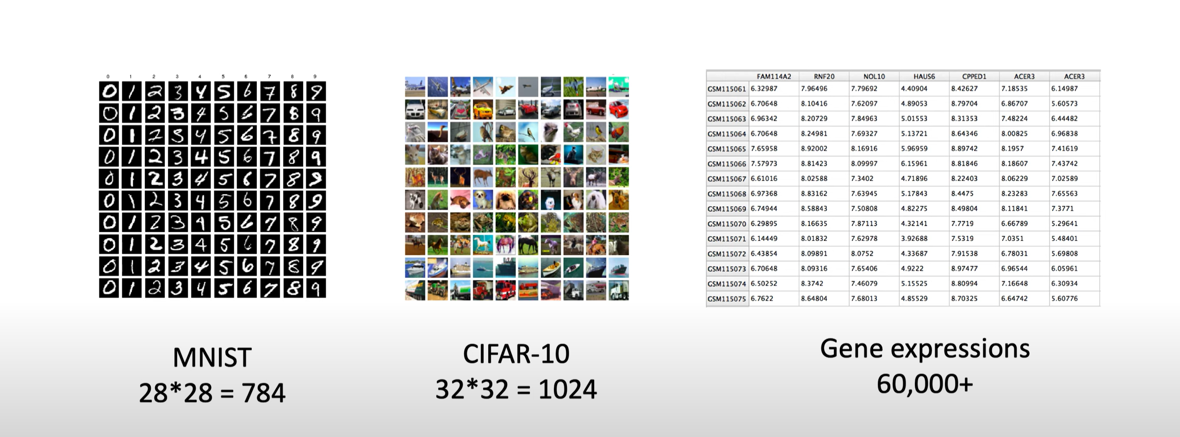
What is t-SNE?
t-SNE is a technique to reduce the dimensions of high-dimensional data and used to visualize it, it's an unsupervised ML algorithm that maps data into lower dimensions while preserving the local structure.

Slide 3
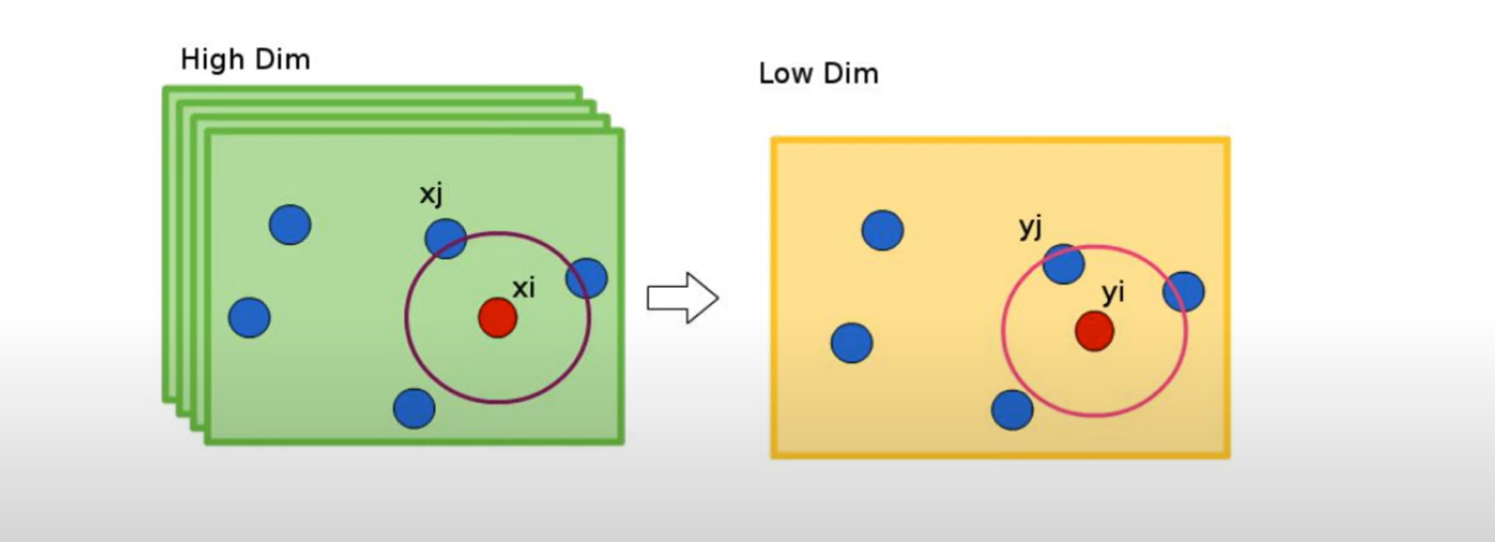
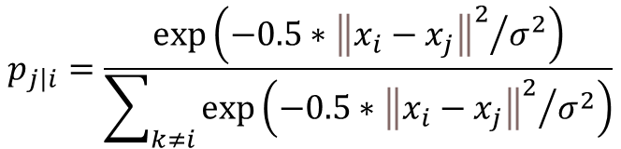
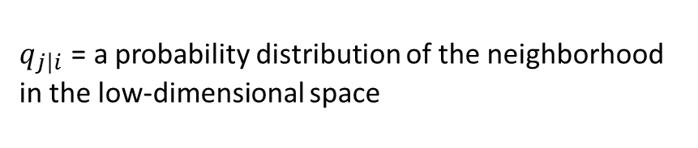
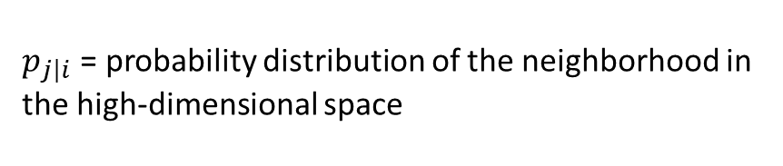
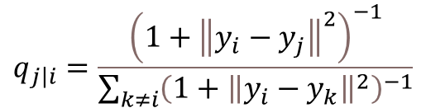
t-SNE(t-distributed stochastic neighbor embedding)
$$p_{\left.j\right|i}=\frac{\exp\left(−0.5∗{{\left\|x_{i}−x_{j}\right\|}^{2}}/{σ^{2}}\right)}{\sum_{k≠i}{\exp\left(−0.5∗{{\left\|x_{i}−x_{j}\right\|}^{2}}/{σ^{2}}\right)}}$$
$$q_{\left.j\right|i}=\frac{{\left(1+{\left\|y_{i}−y_{j}\right\|}^{2}\right)}^{−1}}{\sum_{k≠i}{{\left(1+{\left\|y_{i}−y_{k}\right\|}^{2}\right)}^{−1}}}$$
$p_{\left.j\right|i}$ = probability distribution of the neighborhood in the high-dimensional space
$q_{\left.j\right|i}$ = a probability distribution of the neighborhood in the low-dimensional space

Slide 4
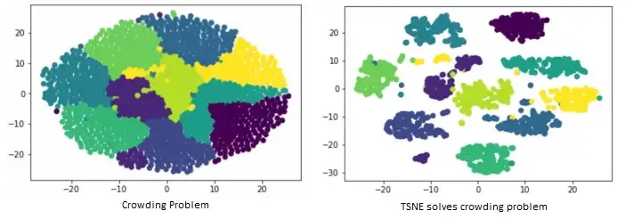
Crowding Problem

Slide 5
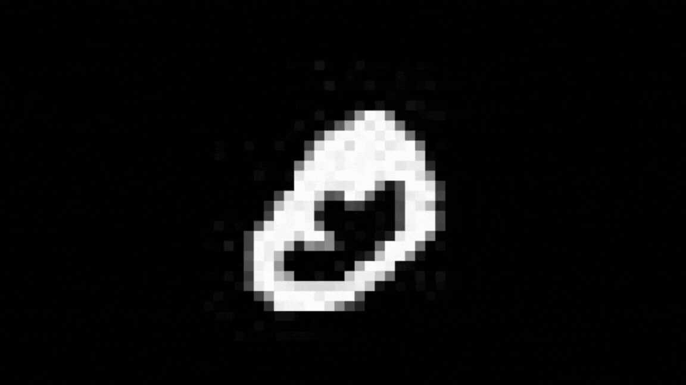

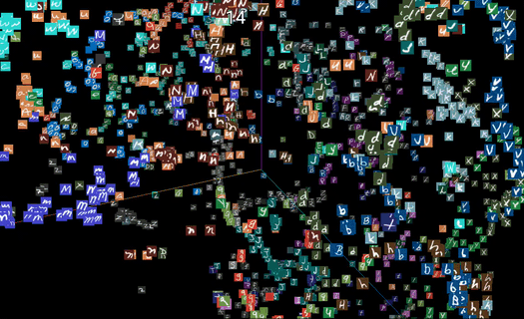
Mnist with t-SNE
http://projector.tensorflow.org/

Slide 6
What the researchers see and want
The main drawback of t-SNE is that it is a transductive approach, meaning that it can only be applied to the specific dataset it was trained on and cannot be applied to new, unseen data
To overcome this limitation, The researchers presents a two-part methodology
The first part adds inductive capabilities to the t-SNE method. By adding inductive capabilities, this methodology makes it possible for t-SNE to generalize from the data it has seen to new, unseen data, whereas previous extensions of t-SNE had only transductive capabilities.
The second part exploits semantic information to perform supervised dimensionality reduction, which results in better separability of the low-dimensional space, this is, it separates better images with no relevance, while retaining the proximity of those images with partial relevance.

Slide 7
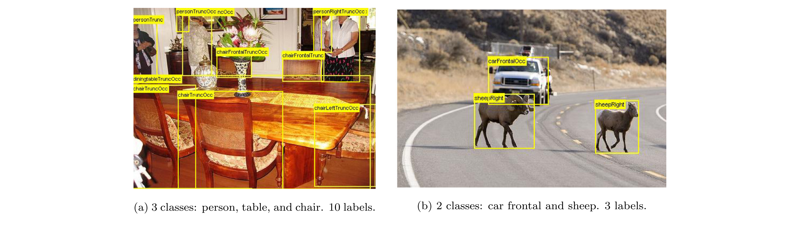
multi-label–multi-instance images
There are problems with manually browsing large catalogs of visual data, particularly imagery containing multi-label-multi-instance images, which are images with multiple occurrences of objects from one or more possible visual classes.
The authors also proposed a measure of partial relevance for multi-label-multi-instance images and evaluate the proposed methodologies with retrieval experiments and visualization scenarios on the PASCAL Visual Object Classes dataset (VOC2012).

Slide 8
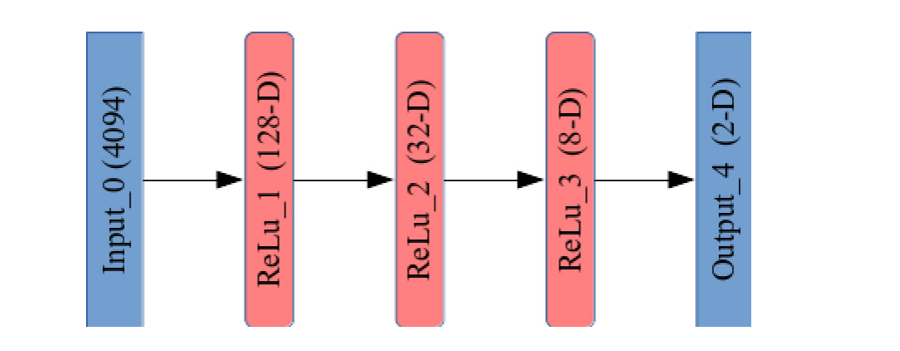
Add inductive capabilities to t-SNE
To add inductive capabilities to t-SNE The authors propose a two-fold process.
First to estimate low-dimensional representations of a training set with the base t-SNE
Then, with the same training set, to train a Deep Neural Network that could learn to approximate/replicate the dimensionality reduction process using pairs (𝑥𝑖 , 𝑦𝑖 ), where 𝑦𝑖 correspond to the lowdimensional representation previously estimated for 𝑥𝑖 .
Our network consists in a series of 5 fully-connected layers, i.e., a Multi-layer Perceptron (MLP), with the following characteristics:
1. The input layer where the high-dimensional representations are to be fed (it lacks of transfer function). Its size corresponds to the dimensionality of 𝑥𝑖 , e.g., 4094-D .
2. Three fully-connected hidden layers with 128, 32, and 8 units, respectively. All units in the hidden layers implement the ReLU activation function.
3. The output layer whose size corresponds to the dimensionality of 𝑦𝑖 , e.g., 2 units in the example shown in next image. All units in this layer are full-connected and implement a sigmoid activation function.
4. The network is trained using stochastic gradient descent (SGD) with mini-batches of 30 examples.
5. SGD relies on a learning rate of 0.001 and momentum of 0.01.
6. It uses the mean square error (mse) as loss function.
7. The network is trained during 300 epochs.

Slide 9
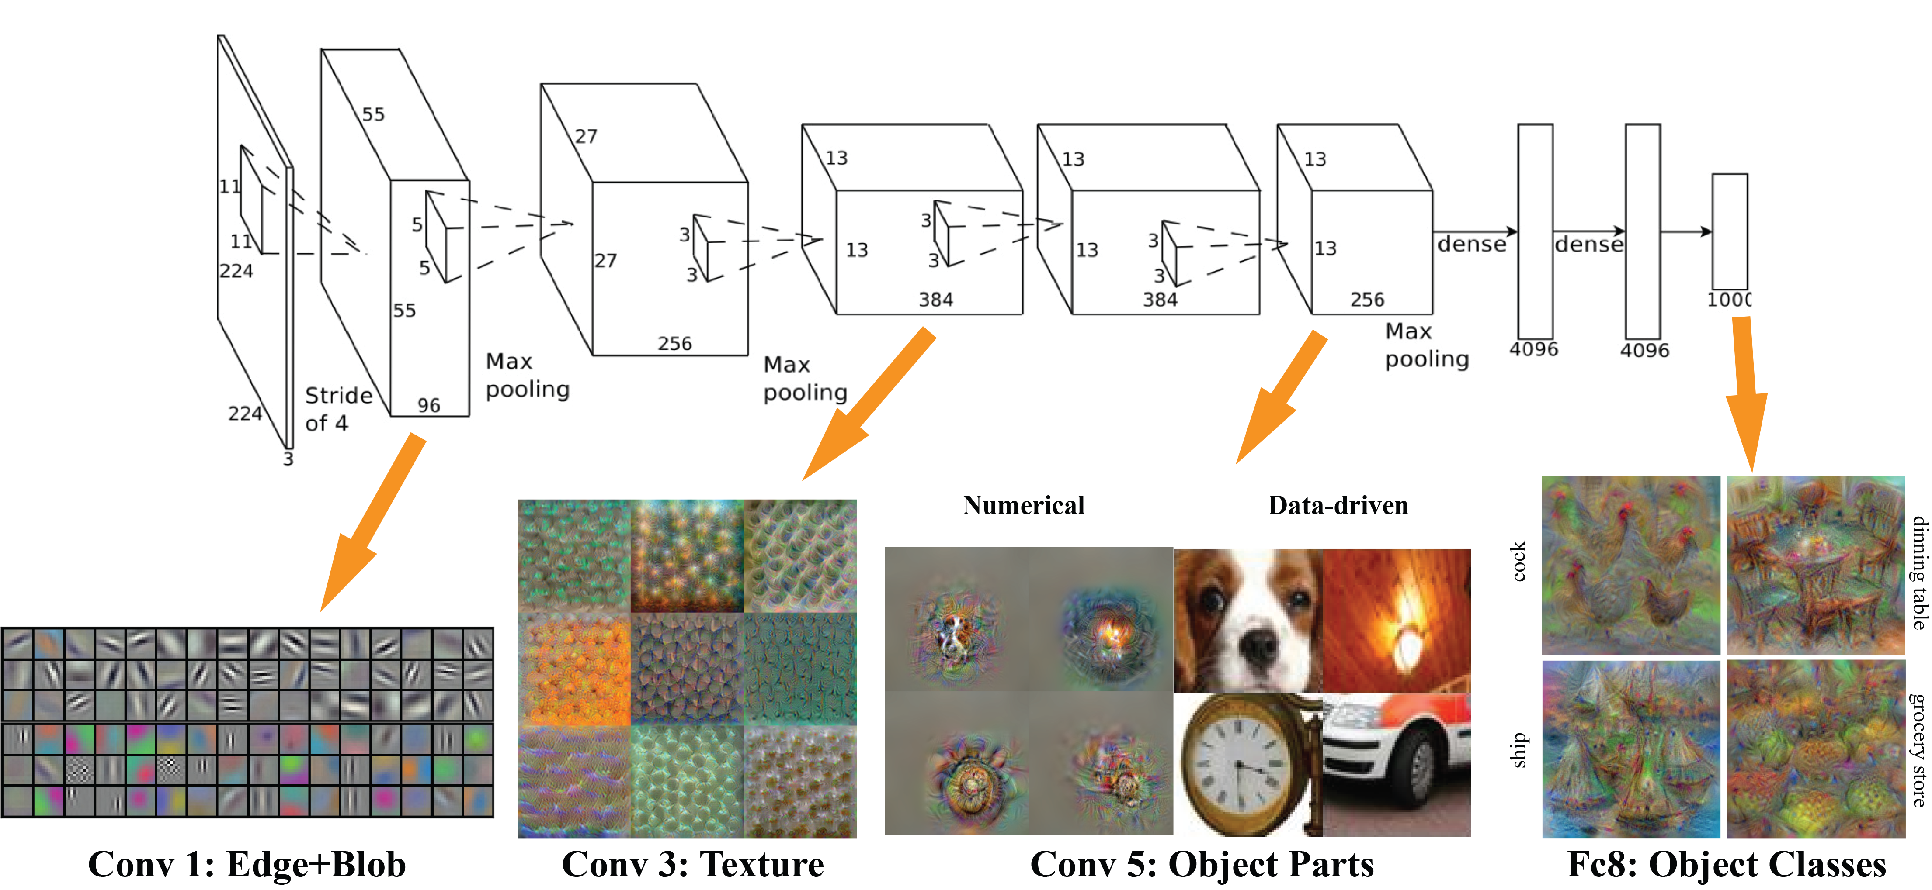
Image description
VGGnet :

Slide 10
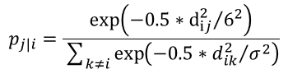
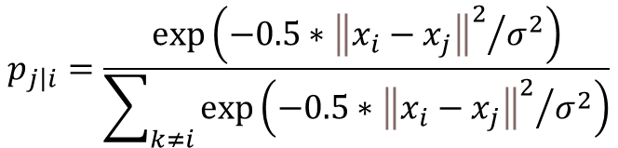
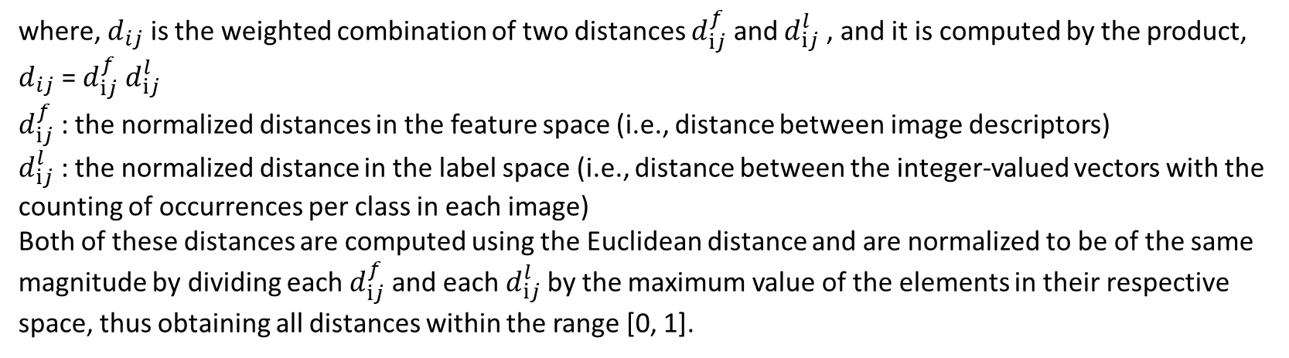
Supervised t-SNE
$$p_{\left.j\right|i}=\frac{\exp\left(−0.5∗{{\left\|x_{i}−x_{j}\right\|}^{2}}/{σ^{2}}\right)}{\sum_{k≠i}{\exp\left(−0.5∗{{\left\|x_{i}−x_{j}\right\|}^{2}}/{σ^{2}}\right)}}$$
where, $d_{ij}$ is the weighted combination of two distances $d_{ⅈj}^{f}$ and $d_{ⅈj}^{l}$ , and it is computed by the product,
$d_{ij}$ = $d_{ⅈj}^{f}$ $d_{ⅈj}^{l}$
$d_{ⅈj}^{f}$ : the normalized distances in the feature space (i.e., distance between image descriptors)
$d_{ⅈj}^{l}$ : the normalized distance in the label space (i.e., distance between the integer-valued vectors with the counting of occurrences per class in each image)
Both of these distances are computed using the Euclidean distance and are normalized to be of the same magnitude by dividing each $d_{ⅈj}^{f}$ and each $d_{ⅈj}^{l}$by the maximum value of the elements in their respective space, thus obtaining all distances within the range [0, 1].

Slide 11
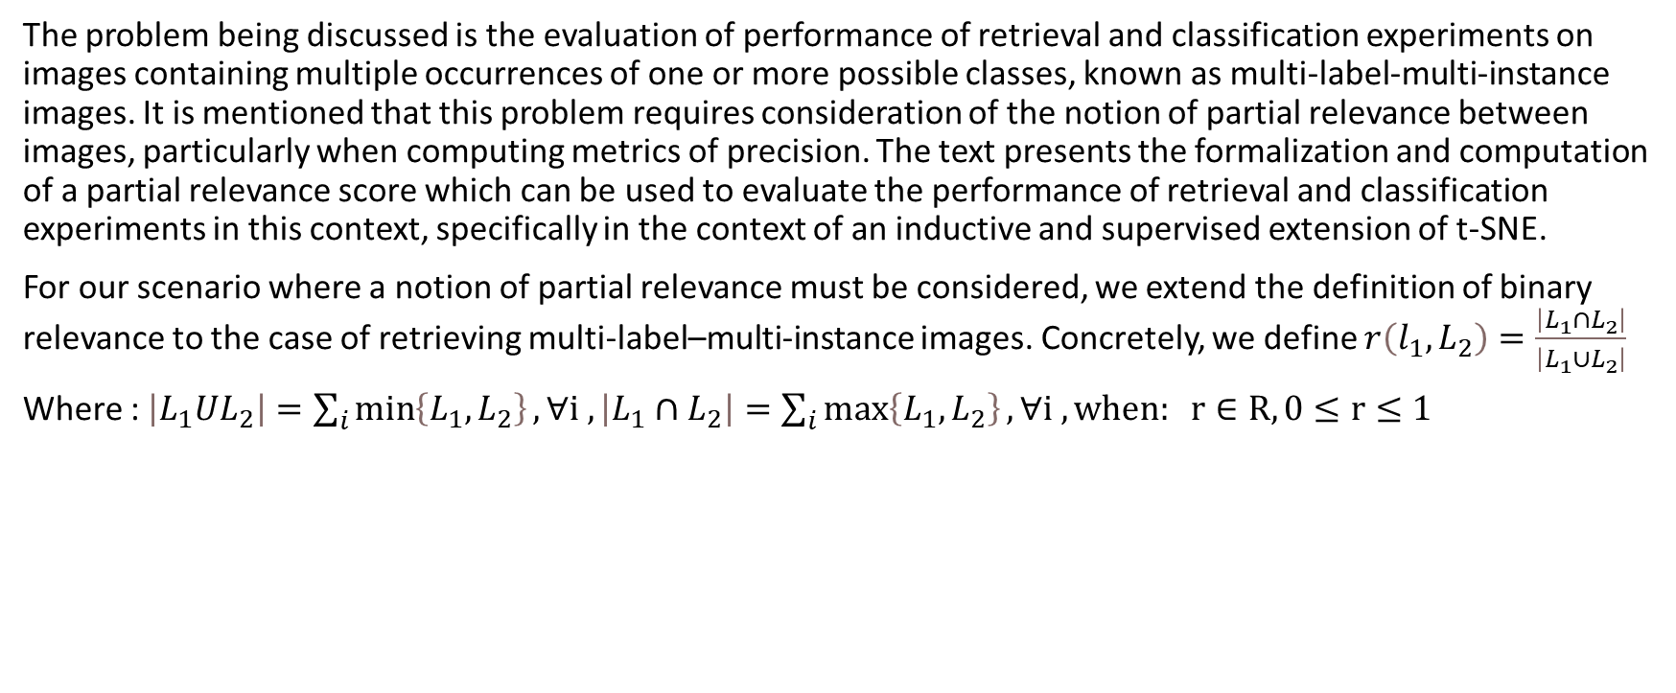
Partial relevance
The problem being discussed is the evaluation of performance of retrieval and classification experiments on images containing multiple occurrences of one or more possible classes, known as multi-label-multi-instance images. It is mentioned that this problem requires consideration of the notion of partial relevance between images, particularly when computing metrics of precision. The text presents the formalization and computation of a partial relevance score which can be used to evaluate the performance of retrieval and classification experiments in this context, specifically in the context of an inductive and supervised extension of t-SNE.
For our scenario where a notion of partial relevance must be considered, we extend the definition of binary relevance to the case of retrieving multi-label–multi-instance images. Concretely, we define $r\left(l_{1},L_{2}\right)=\frac{\left|L_{1}∩L_{2}\right|}{\left|L_{1}∪L_{2}\right|}$
Where : $\left|L_{1}UL_{2}\right|=\sum_{i}{\min\left\{L_{1},L_{2}\right\}},∀ⅈ , \left|L_{1}∩L_{2}\right|=\sum_{i}{\max\left\{L_{1},L_{2}\right\}},∀ⅈ , when: r∈R, 0≤r≤1$

Slide 12
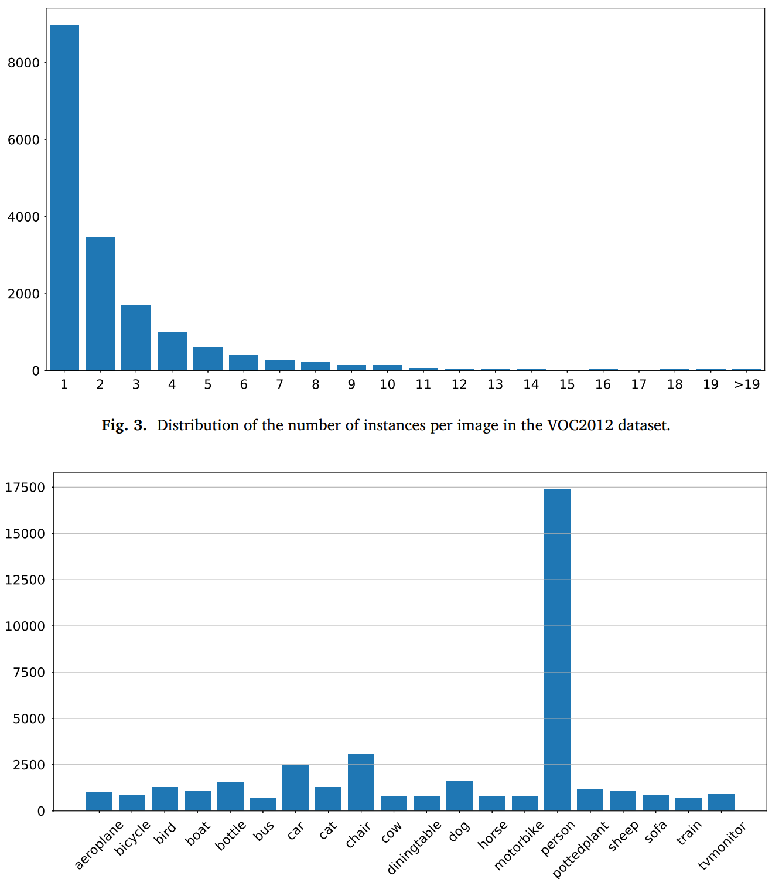
Data
They used the 2012 PASCAL Visual Object Classes dataset (VOC2012)
This dataset is readily relevant to our scenario because:
(1) it contains instances of objects from 20 visual classes
(2) instances are shown at different scales and orientations in realistic scenes
(3) images might contain more than a single instance from one or more visual classes
(4) all images are labeled with the instances they contain.
the VOC2012 dataset consists of 17,125 images containing in total 40,124 object instances.
Data organization:
For some of our experiments, i.e., those requiring training and test sets, we randomly split the dataset into 9000 instances for training, 4000 for validation,
and the remaining 4125 for testing.
And build Label description for each image.

Slide 13
visualizations with label
Given the multi-instance nature of the images in the VOC2012 dataset, it is difficult to assign a single color to these images (i.e., points in 2-D) for visualization purposes. Therefore, we relied on the following color code: (1) assign a different color to each of the 20 classes of the VOC2012 dataset
(2) compute a weighted average color for each image, where weights correspond to the normalized values in the label vectors 𝑙, i.e., proportion of each class contained within an image.
Using this approach, points with exactly the same color correspond to images having exactly the same number of objects and from the same classes, while images with partial relevance will be mapped to points that are close to one another in the color space.

Slide 14
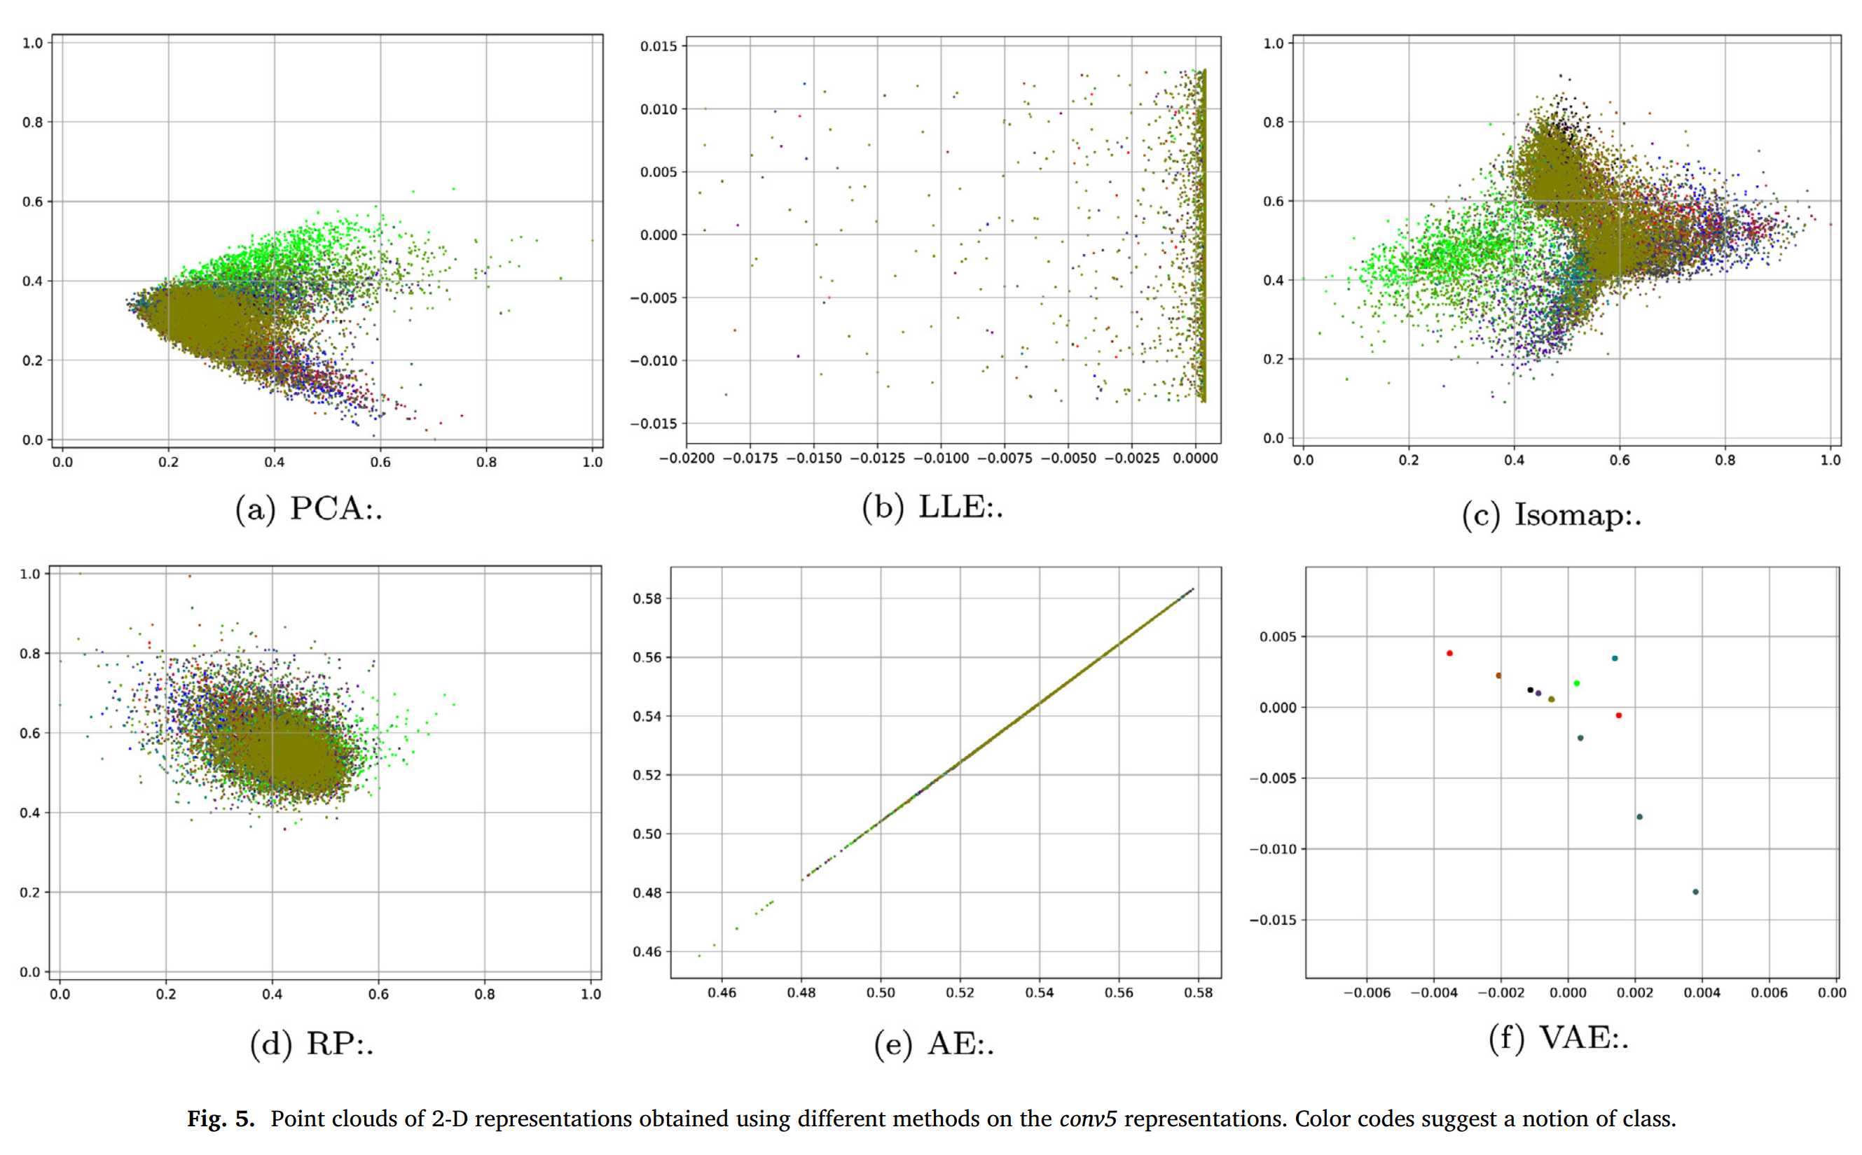

Slide 15
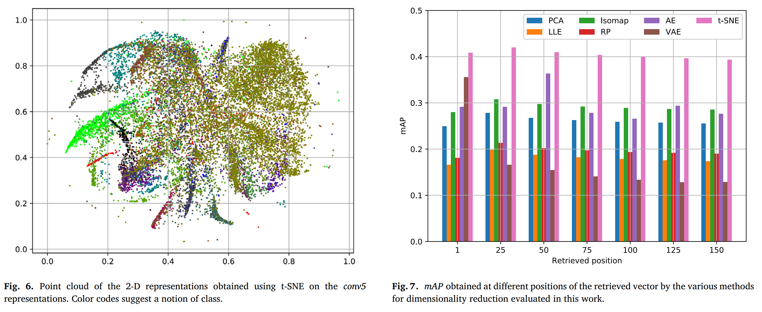
The mean Average Precision : measure the average precision of a set of retrieved images.

Slide 16
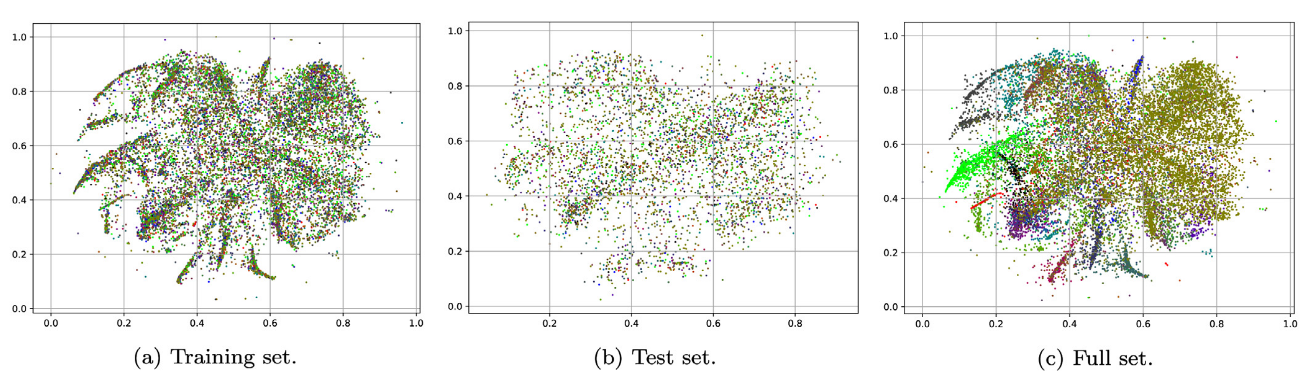
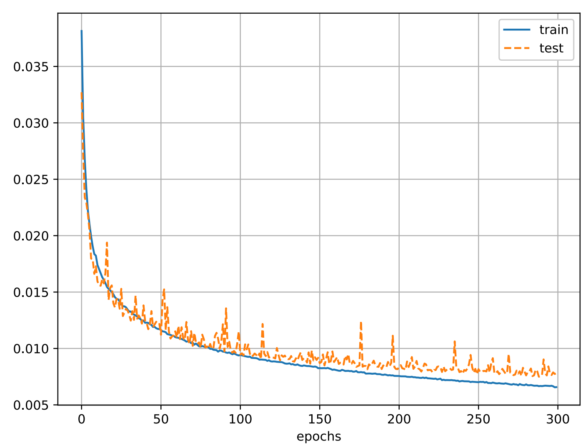
This performance was consistent for all 20 runs,
with its worst scenario stopping optimization at 0.064,
and its best one at 0.038 (mean square error) for the training loss.

Slide 17
Conclusions
Presents a methodology for using the t-SNE method for dimensionality reduction in a way that allows it to be reused on unseen data and shows that this approach outperforms other methods in retrieval experiments.
Additionally, an approach for supervised dimensionality reduction on collections of multi-label, multi-instance images is presented, which addresses limitations of previous methods and increases the separability of images with no relevance while retaining those with partial relevance.

